Slide 1
Architectural Best Practices
The world’s most popular enterprise open source products for real-time search, metrics logging, analytics, and more

Slide 2
Architectural Best Practices
The world’s most popular enterprise open source products for real-time search, metrics logging, analytics, and more

Slide 3

What I wish I knew about mappings
Elasticsearch auto-generated mappings can be suboptimal
Sample document
Auto-generated mapping
Problems
{
"line" : 4,
"play" : "HENRY IV",
”speech" : "So shaken as we are, so wan with care,"
}
"line": {
"type": "long"
},
"play": {
"type": "text",
"fields": {
"keyword": {
"type": "keyword",
"ignore_above": 256
}
}
},
”speech": {
"type": "text",
"fields": {
"keyword": {
"type": "keyword",
"ignore_above": 256
}
}
}
Numeric default to long where int is sufficient
‘play’ field mapped as both text and keyword
‘speech’ should only be type text

Slide 4
Specialized nodes for specialized tasks
Use dedicated node types whenever possible
Data Nodes
  Store data and execute queries
Master Nodes
  Maintain consistent view of cluster metadata and state
Coordinator Nodes
  Coordinate distributed execution of queries
Ingest Nodes
  ETL transformations on newly indexed data
Machine Learning Nodes
  Execute machine learning jobs

Slide 5
Observations about shards and replicas
It all depends on your data…
What is the optimal shard size?
  A good rule of thumb is between 40 – 80 GB
  Generally sub-optimal to have lot’s of small shards
  A single shard can actually have 100’s of GB and still perform well
  YMMV
How many replicas are optimal
  Usually start with 1 replica
  Add more to scale out query processing
Test empirically with Rally

Slide 6
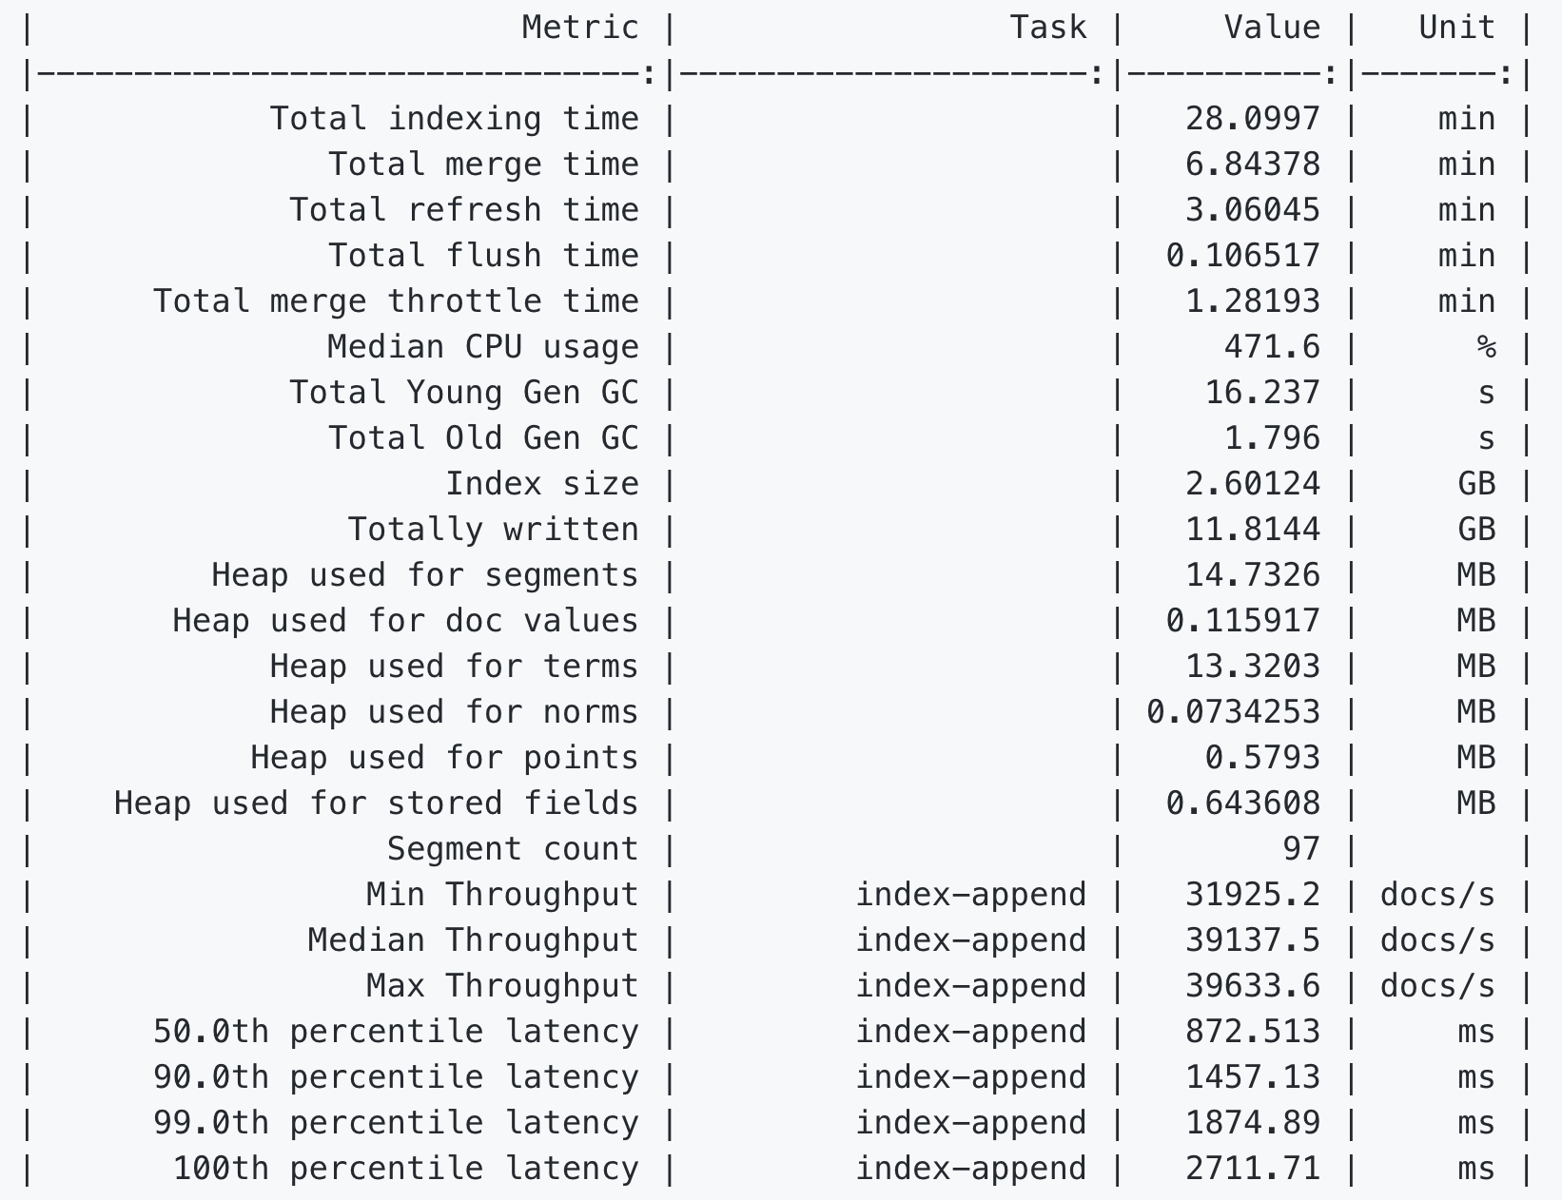
Rally – Our open-source benchmarking framework
https://github.com/elastic/rally

Slide 7
Managing indices with shard splitting
Add index capacity after the fact
Fewer up-front concerns about choosing the best number of shards
Scale up based on need
Complements the shrink API
 |  |  | 1 | 2 | 3 | 4 | 5 | 6 | 7 | 8 | 9 | 10 | 11 | 12 | 13 | 14 | 15 | 16
number_of_shards: 1
_split
_split
_split
_split

Slide 8
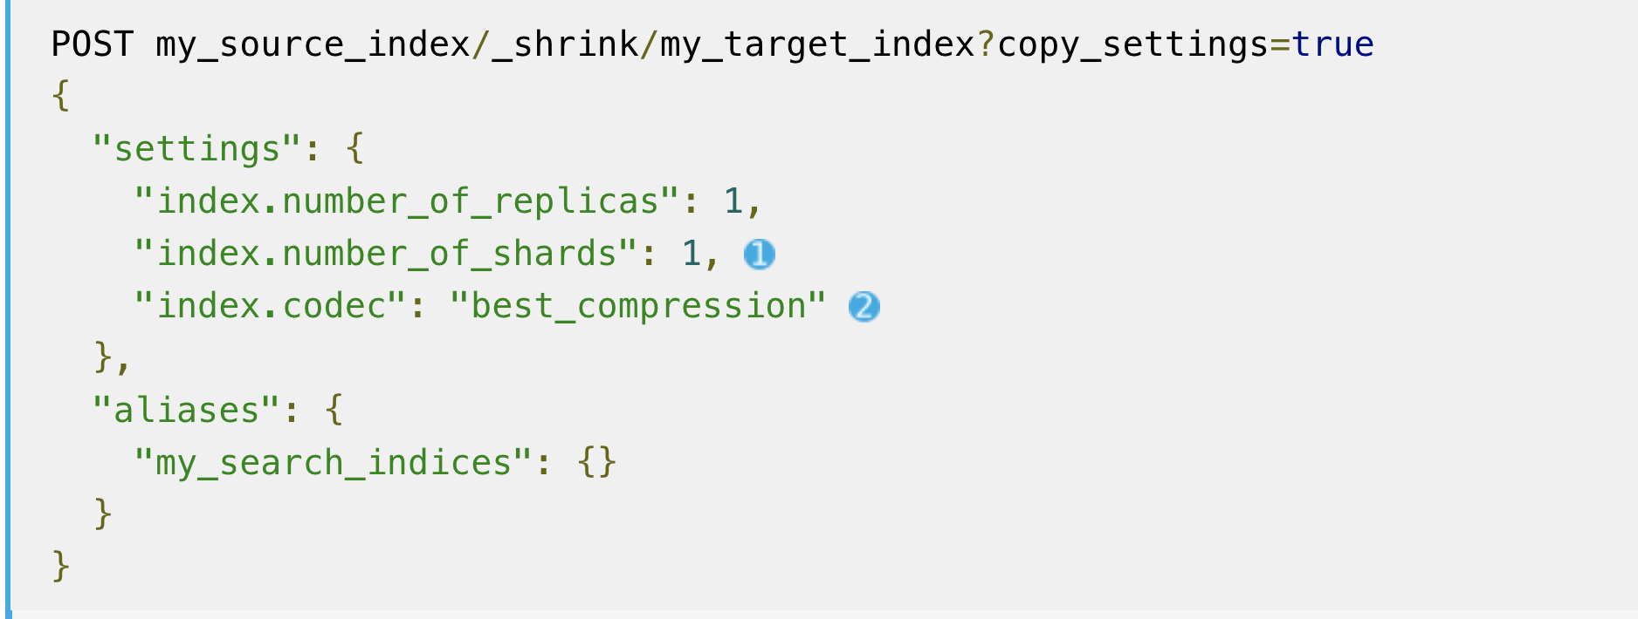
Shrinking indices
Consolidating for long-term retention
Save space on old indices with long-term retention

Slide 9
Rollups for fast queries on large metric data sets
Save space and execute faster on time-series data
Save space
Faster queries on time-series data
Faster aggregations on time-series data
Ingest Nodes
  Small backups
  Fewer nodes
Same API as _search

Slide 10
Rollups for fast queries on large metric data sets
Save space and execute faster on time-series data
 | Raw | Minute | Hour | Day
Docs: | 9,041,000 | 1,448,285 | 49,554 | 8,447
Size: | 2.23gb | 1.25gb | 48.40mb | 9.10mb
Docs % change: |  | -83.98% | -99.45% | -99.91%
Size % change: |  | -43.68% | -97.84% | -99.59%

Slide 11
Index sorting
Faster sorted queries by optimizing on-disk layout
5.x
6.x
Optimize on-disk format for some search use cases
Improve query performance at the cost of index performance
Queries can return early if sorted the same as the index time sort
Player 1
Score: 600
Player 1907
Score: 800
Player 2
Score: 0
Query for top 3 player scores
Query for top 3 player scores
Player 4
Score: 700
Player 3
Score: 200
Player 1
Score: 600
Player 4
Score: 700
Player 5
Score: 300
Player 5
Score: 300
Player 3
Score: 200
...
...
Player 1907
Score: 800
Player 2
Score: 0

Slide 12
Index sorting

Slide 13
Index sorting

Slide 14
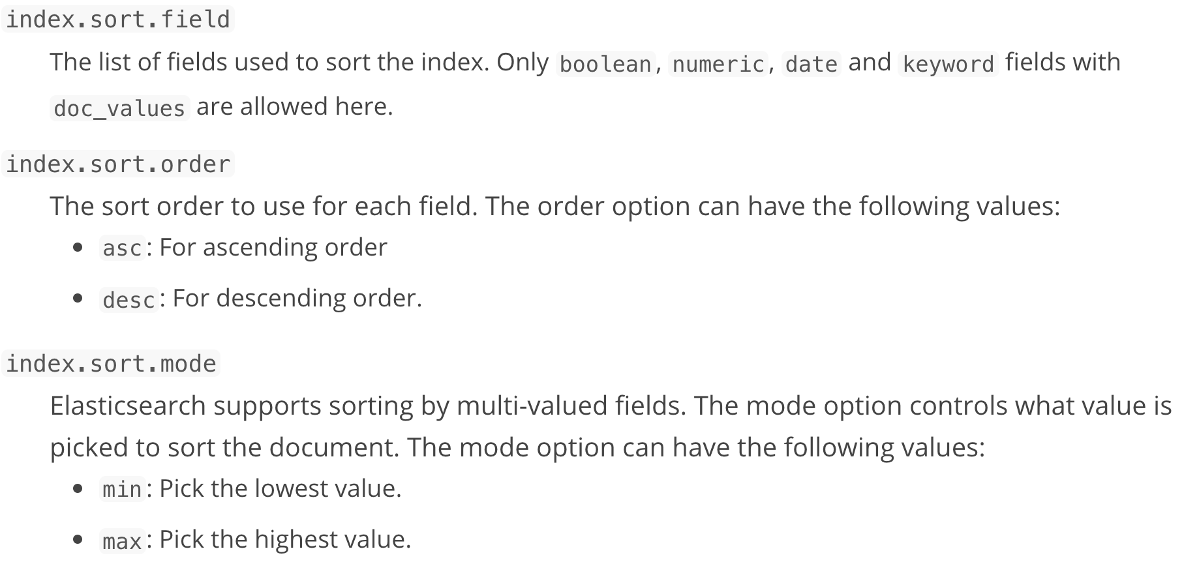
Index sorting
Use only when it is clear you have a dominant sort criteria
Decide at index-time what fields will most commonly be used to sort
Sorting on timestamp generally a bad idea

Slide 15
Index sorting
Use only when it is clear you have a dominant sort criteria
Decide at index-time what fields will most commonly be used to sort
Sorting on timestamp generally a bad idea

Slide 16
Anti-patterns
Bulk thread pool – resist the temptation to increase it
ESRejectedExecutionException
Caused by: org.elasticsearch.common.util.concurrent.EsRejectedExecutionException: rejected execution of org.elasticsearch.transport.TransportService$7@2c114f72 on EsThreadPoolExecutor[name = foo/write, queue capacity = 1000, org.elasticsearch.common.util.concurrent.EsThreadPoolExecutor@14eb2d01[Running, pool size = 40, active threads = 40, queued tasks = 1004, completed tasks = 9172355]]
These are _not_ errors, they are indicators to the upstream client to throttle rate of ingest
Increasing cluster capacity is one possible solution
May need to re-examine data model
Reduce refresh interval to 5 or 10 seconds

Slide 17
Anti-patterns
Do not override the auto-generated _id field
Elasticsearch uses a fast UUID
Specifically designed to work with internal data structures for fast lookups
http://blog.mikemccandless.com/2014/05/choosing-fast-unique-identifier-uuid.html

Slide 18
Anti-patterns
Without proper isolation, multiple nodes per machine can be bad
Multiple nodes per machine is okay, but only with proper resource isolation
Nodes should have dedicated disk volumes
Avoid multi-path data directories
Recommend using Docker to isolate nodes
If not using containers, do not give Elasticsearch all the CPU cores. Use the processors: N setting in elasticsearch.yml
Consult your hardware and OS documentation for NUMA considerations

Slide 19
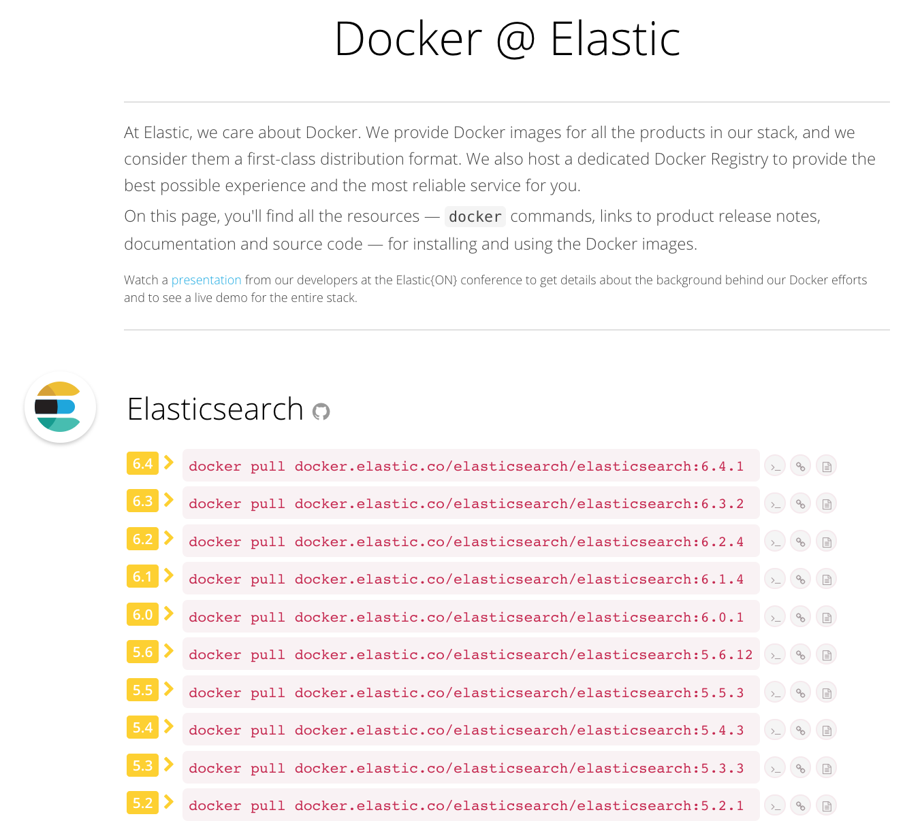

Slide 20
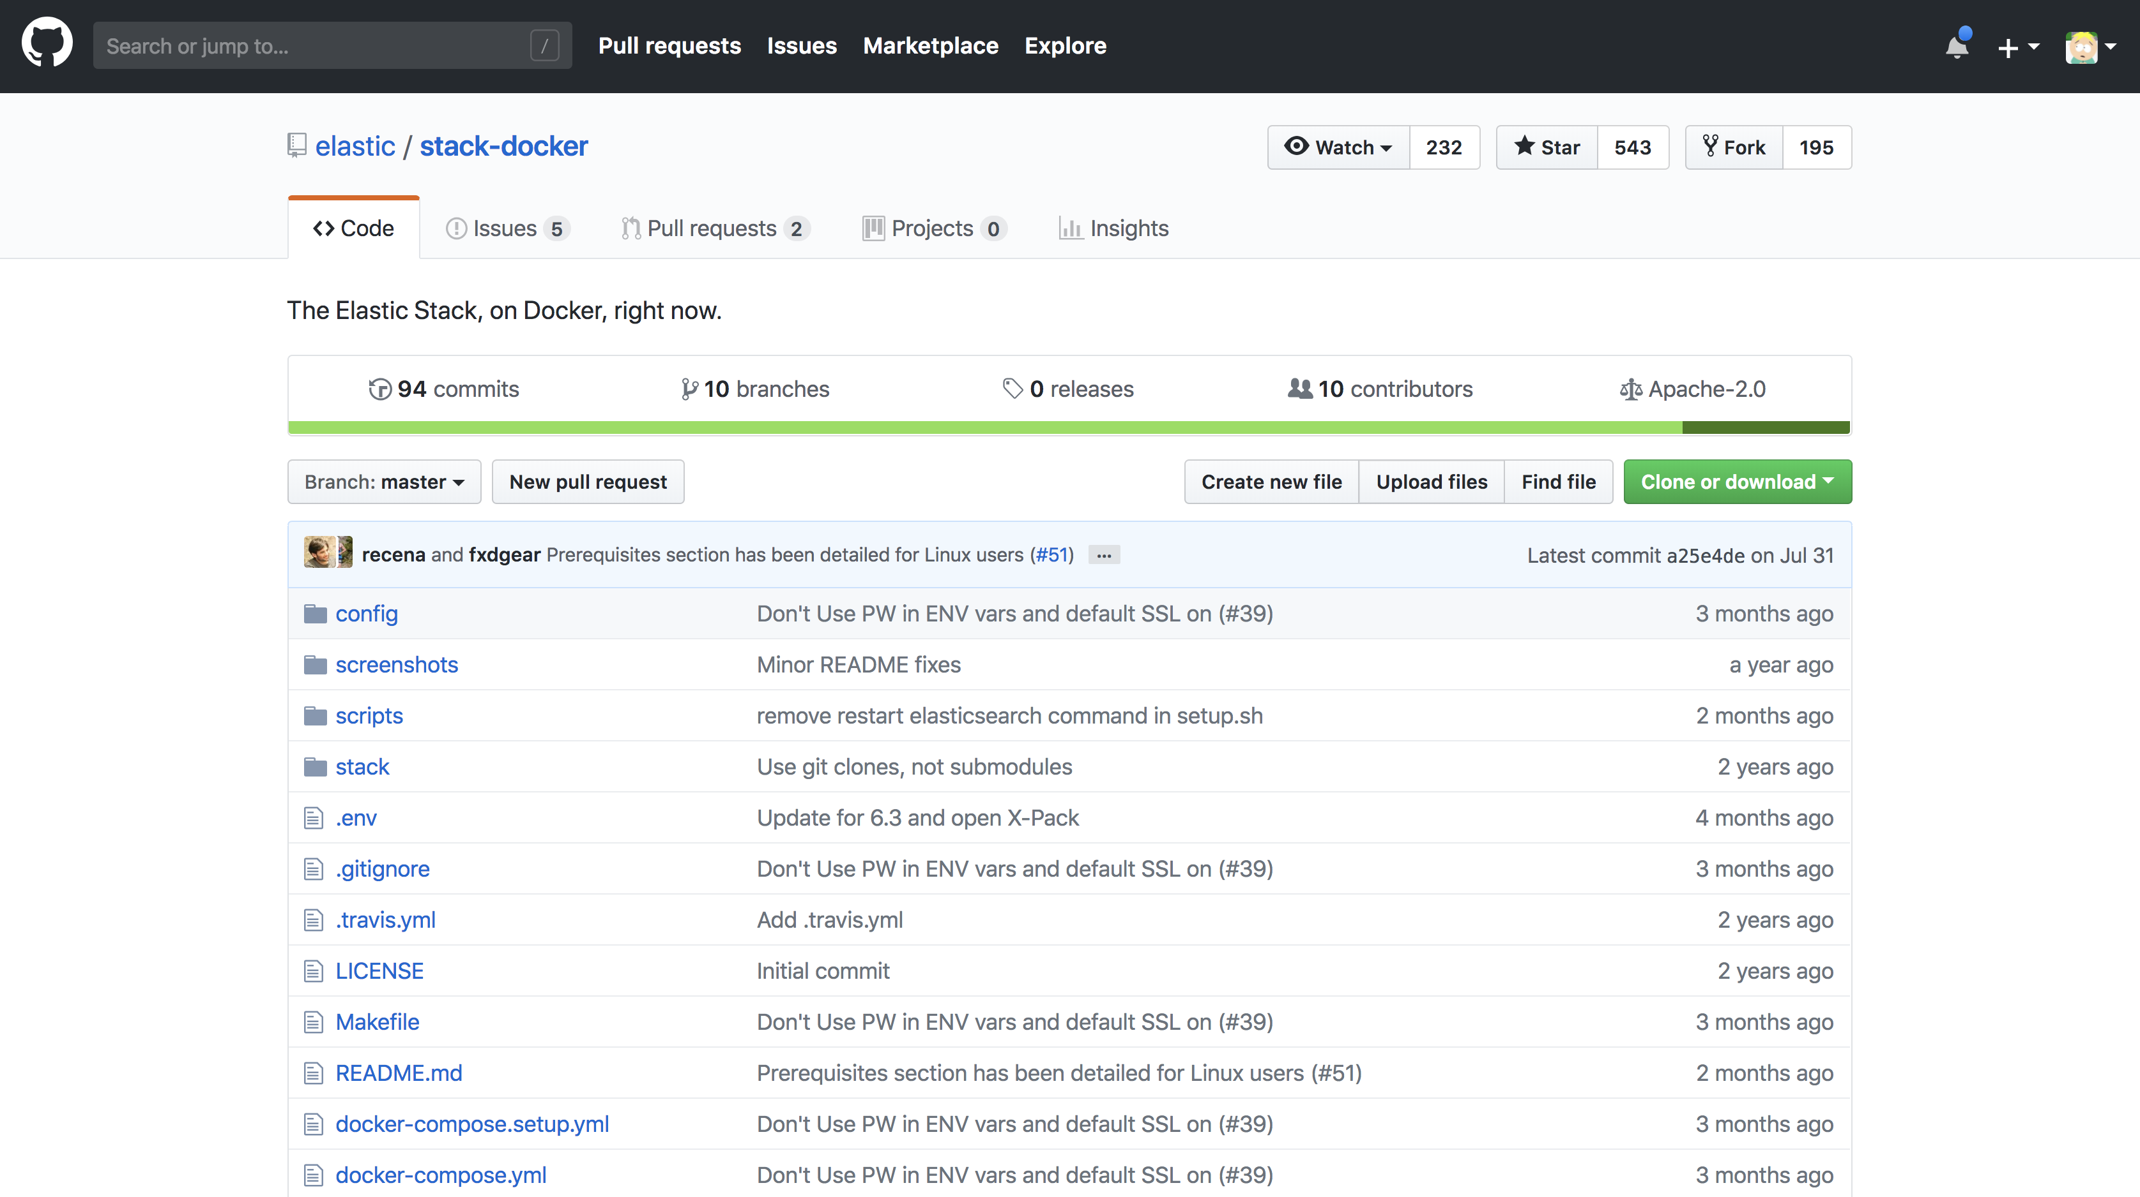

Slide 21
Some recent improvements

Slide 22

Adaptive Replica Selection
Historic behavior is round robin
Coordinating node
Round Robin
primary
replica1
Without adaptive replica selection

Slide 23
Adaptive Replica Selection
But sometimes you’re in a noisy-neighbor situation and that’s not great
Coordinating node
Round Robin
machine 2
machine 1
primary
replica1
tenant 2
tenant 3
Without adaptive replica selection

Slide 24

Adaptive Replica Selection
Or you could have a degraded disk, causing slower response times
Coordinating node
Round Robin
degraded disk
r1
r2
Without adaptive replica selection

Slide 25
Adaptive Replica Selection
Accounting for node performance in searches
Coordinating node
q̂(s) = 1 + (os(s) * n) + q(s)
Ψ(s) = R(s) - 1/µ̄(s) + (q̂(s))^b / µ̄(s)
Adaptive
degraded disk
r1
r2
With adaptive replica selection
Notes:
Based on C3 paper: https://www.usenix.org/system/files/conference/nsdi15/nsdi15-paper-suresh.pdf
Uses an exponentially weighted moving average
q(s) = queue size, os(s) = outstanding requests, n = number of clients in the system
os(s) * n = "concurrency compensation"
R(s) = response time seen from coordinating node, µ̄(s) = service time, b = penalty (arbitrary)
Still a bit rough: we could choose different values for b (currently=3), track different metrics, etc. Would love feedback.

Slide 26

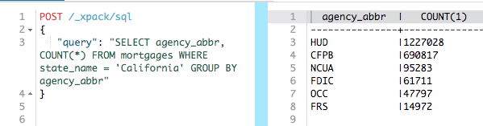
Use the query language you already know
For Data Scientists
JDBC
Tabular return format

Slide 27
Elastic SQL
POST /_xpack/sql/translate
{
"query": "SELECT agency_abbr, COUNT(*) FROM mortgages WHERE state_name = 'California' GROUP BY agency_abbr"
}
{
"query" : {
"term" : {
"state_name.keyword" : {
"value" : "California"
}
}
},
"_source" : false,
"stored_fields" : "_none_",
"aggregations" : {
"1015" : {
"terms" : {
"field" : "agency_abbr",
"size" : 512,
For Our Developers
JDBC client
REST endpoint
CLI

Slide 28
Composite Aggs
Aggregations meet pagination
Efficiently work with large aggregation results by paginating
Return all aggregation results, without setting a maximum size
Supports page and limit parameters

Slide 29
Composite Aggs: Sample Use Case
Let’s aggregate pageviews for a Google Analytics type application
Millions of URLs
API/programmatic access to aggregation results
URL | Access Time
http://elastic.co | 2017-12-15T12:10:30Z
https://www.elastic.co/guide/index.html | 2017-12-15T12:10:40Z
http://elastic.co | 2017-12-15T12:10:55Z
URL | Pageviews
http://elastic.co | 20,000
https://www.elastic.co/guide/index.html | 5,000
https://www.elastic.co/guide/en/elasticsearch/reference/current/index.html | 2,000

Slide 30
Composite Aggs: Sample Use Case
Let’s aggregate pageviews for a Google Analytics type application
GET page-views/_search
{
"aggs" : {
"my_buckets": {
"composite" : {
"size": 10,
"sources" : [
{ "url": { "terms" : { "field": "url", "order": "desc" } } }
]
}
} } }

Slide 31
Composite Aggs: Sample Use Case
Let’s aggregate pageviews for a Google Analytics type application
GET page-views/_search
{
"aggs" : {
"my_buckets": {
"composite" : {
"size": 10,
"after": { "url": "https://www.elastic.co/guide/en/elasticsearch/reference/current/index.html" },
"sources" : [
{ "url": { "terms" : { "field": "url", "order": "desc" } } } ]
} } } } }

Slide 32
Thank you!
Notes:
Overview of strategy, team, and roadmap for deliverables. Ideas for FY19.

