Slide 1
WISE
With Intelligence See Everything
Andy Wick

Slide 3
What is it
Moloch SPI data enhancer
Can match on host/domains, md5, url, ip, ja3, email
Can set almost any field in SPI data
Can add menu options (called right clicks still)
Supported data sources
Simple Files
Commercial Services: OpenDNS, Emerging Threats Pro, Threatstream, …
Elasticsearch/Redis
Multilayer caching
Capture
Redis

Slide 4
SPI Data Sample - Threatstream

Slide 5
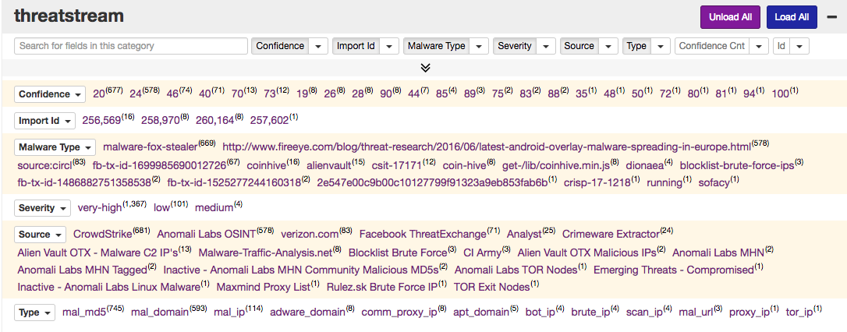
SPI View Sample - Threatstream

Slide 6
Architecture
For performance reasons lookups are cached at multiple layers.
Check wise cache in capture (ALWAYS)
Check wiseService cache (for some sources)
Check redis cache (if configured)
Ask the data source for information
capture
redis
Threatstream
wise
cache
capture
wise
Files
wise
cache
wise
cache
capture
Other Sources
wise
cache

Slide 7
Capture & Viewer Configuration
# Set in [default] and/or for each capture node
wiseHost=wisehost.example.com
# Semicolon ';' separated list of viewer plugins to load and the order to load in
viewerPlugins=wise.js
# Semicolon ';' separated list of plugins to load and the order to load in
plugins=wise.so

Slide 8
Data source configuration
Like capture/viewer, everything in an ini file
Each data source has its own section
Some sections are unique like [threatstream]
Some sections have prefixes like [file:filename] and [url:urlname]
Most feeds just require simple configuration with defaults being good enough
All WISE sources implement some common options
cacheAgeMin - For those that cache
excludeDomains, excludeEmails, excludeURLs - don’t lookup matching items
excludeEmails, excludeURLs - support wildcards
excludeIPs - CIDR
See WISE wiki entry for configuration options

Slide 9
Sample WISE Configuration
# wiseService contains global settings and global excludes
[wiseService]
excludeDomains=*.zen.spamhaus.org;*.in-addr.arpa;*.dnsbl.sorbs.net;*.ip6.arpa
[emergingthreats]
key=0000000000
[reversedns]
ips=10.0.0.0/8
field=asset
[file:badbadbad.ip]
file=/data/moloch/wisefiles/badbadbad.ip
tags=badbadbad
type=ip
format=tagger

Slide 10
Tagger Format - badbadbad.ip
#field:whatever.str;kind:lotermfield;count:true;friendly:A String;db:whatever.str-term;help:Help for String;shortcut:0
#field:tags;shortcut:1
10.0.0.1;0=this is really bad;1=reallyBadTag 10.0.0.2;tags=anotherRealBadTag 10.0.0.3

Slide 11
CSV Format - Alexa
Need to set the column number to use for key and extra fields in config file
[file:alexa]
type=domain
format = csv
column=1
file = /wisefiles/top-1m.csv
fields=field:alexa.rank;kind:integer;count:false;friendly:Alexa Rank;db:alexa.rank;help:Alexa Rank;shortcut:0
1,google.com
2,youtube.com
3,facebook.com

Slide 12
Alexa Example

Slide 13
JSON Format - IPAM
[url:ipam]
type = ip
format = json
url = https://exampl.com/getipam.json
reload = 60
keyColumn = CIDR
fields=field:ipam.datacenter;kind:termfield;count:false;friendly:DataCenter;db:ipam.dc-term;help:DataCenter;shortcut:DataCenter\nfield:ipam.zone;kind:termfield;count:true;friendly:Security Zone;db:ipam.zone-term;help:Security Zone;shortcut:SecurityZone

Slide 14
JSON Sample Data
[{"DataCenter": "none",
"SecurityZone": "none",
"CIDR": "10.0.0.0/8"},
{"DataCenter": "none",
"SecurityZone": "office",
"CIDR": "10.66.0.0/16"}]

Slide 15
IPAM Example

Slide 16
Elasticsearch Source - Get username from panos
[elasticsearch:user]
type=ip
onlyIPs=10.10.0.0/16
elasticsearch=https://elk.example.com:9200
esIndex=panos-*
esTimestampField=@timestamp
esQueryField=sourceIP
esMaxTimeMS=86400000
esResultField=sourceUserName
fields=field:user;shortcut:sourceUserName
{"sourceIP" : "10.10.10.10",
"sourceUserName" : "andywick",
"@timestamp" : "2014-11-13T00:13:32.000Z", ...}
= Our VPN space
= index to search against
= what field has the timestamps
= field to check against
= range of data to search around
= what json field must exist in results
= what SPI data fields to set

Slide 17
Creating a new source
Will the new source download the data and load it?
This is usually the better solution
Schedule downloads of data
Mark results as not needing to be cache
Or Does the new source use an API
The wiseService will handle all the caching
API should support bulk queries
Needs to handle rate limits
Start with one already there
Hope to have a wiki page soon

