Slide 1
Network Packet Brokers
Andy & Atif
Disclosure: Atif is from Arista, Oath uses Arista, Arista is sponsoring Happy Hour

Slide 2
What is a NPB
NPB is a device that provides a means for aggregating traffic from taps and SPAN ports toward one or more analysis applications/platforms in 1:many, many:1 or many:many configuration
Allows for easy horizontal scaling of Moloch and other security tools
Used to be purpose built highly specialized hardware
Tap/Span
Tap/Span
Tap/Span
NPB
Moloch 1
Moloch 2
Fireeye

Slide 3
Why use a NPB
Easy to add Moloch capacity
Allows the networking team and security team to act more independently
Networking team can add more links at any time, just connect taps to NPB
The security team can add more tool capacity at any time, just connect tools to NPB
Move the traffic filtering from a bpf to purpose built hardware
Multiple tools can see the same traffic (or subset), again making network team happy they aren’t involved
Load balancing
Handles HA issues of packets taking different paths
as long as all paths hit the same NPB

Slide 4
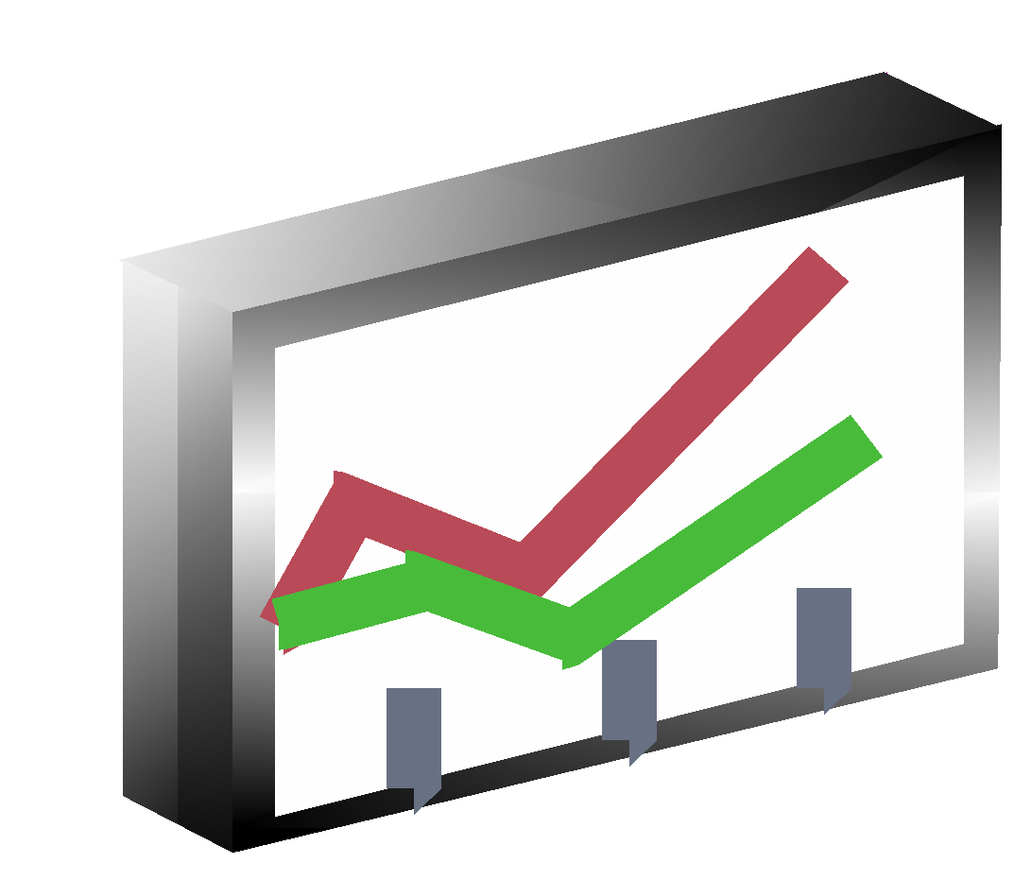
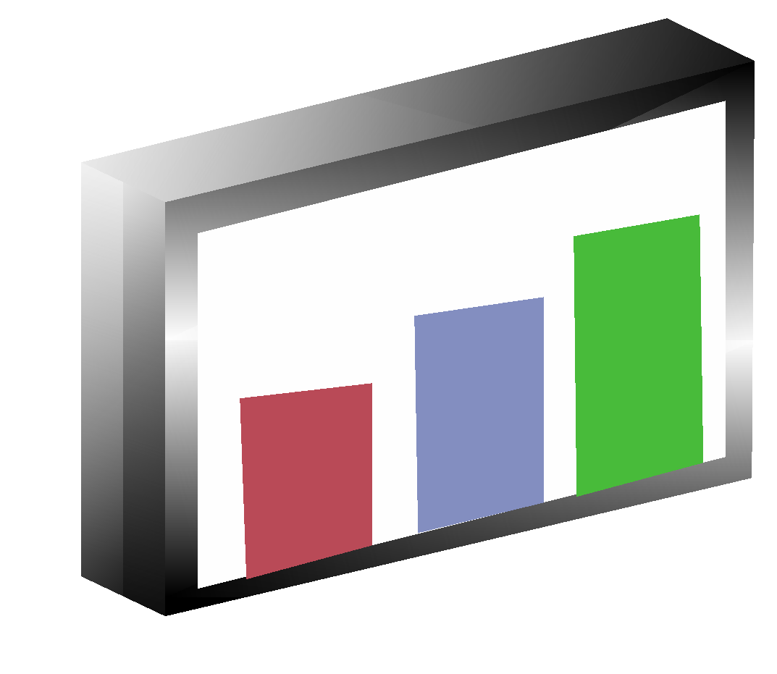
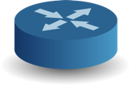
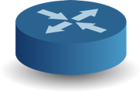
NPB Features To Pay Attention To:
Intelligent load balancing and consistent symmetric hashing - each direction of a flow goes out the same tool port
Enable 10G Tools on 100G networks
Visibility Network
DANZ TAP Aggregation
Monitoring
Tools
100G Traffic
10%
10%
10%
10%
10%
10%
10%
10%
10%
10%
10G Tools
Symmetric/Dynamic distribution of flows
across Nx10G

Slide 5
NPB Features To Pay Attention To:
Traffic Steering (IPv4 and IPv6) - Ability for different security tools to get different streams
10.0.0.0/24
Eth 2
11.1.0.0/24
11.1.0.0/24
Eth 1
12.2.0.0/24
12.2.0.0/24
switchport mode tool
switchport tool group set GROUP1
www
service-policy type tapagg input PMAP2
switchport mode tap
switchport tap default group GROUP1
Eth 3
11.1.0.0/24
12.2.0.0/24
switchport mode tool
switchport tool group set GROUP1
Eth 4
10.0.0.0/24
switchport mode tool
switchport tool group set GROUP2
Eth 5
www
switchport mode tool
switchport tool group set GROUP3
arriving data
tagged/untagged
tap port configuration
tool port configuration
output
packets

Slide 6
NPB Features To Pay Attention To:
MPLS/VLAN/VPN stripping - some security tools require headers to be removed
Visibility Network
NPB
L2 Header
MPLS Header
User Traffic
Header removal
at Wire Speed
Monitoring
Tools
Filtered User Traffic
L2 Header
User Traffic
Service Provide Backbone

Slide 7
Some Other NPB Features:
Automation capability - use ansible/apis or are you stuck using a web ui?
Do features desired require an extra (expensive?) component and/or license
Open and Programmable Operating System
Buffers
Density - Data Centers moving to 100G
Has anyone used TCPDUMP on NPB ????

Slide 8
How Oath uses NPBs
Office sites
Traffic reduction
Multiple security tools
Multiple Moloch boxes for retention requirements
Handle HA issues
Production sites
Traffic reduction
Multiple Moloch boxes for CPU/Traffic rate support
Removal of MPLS
Combine multiple HA and routing paths

Slide 9
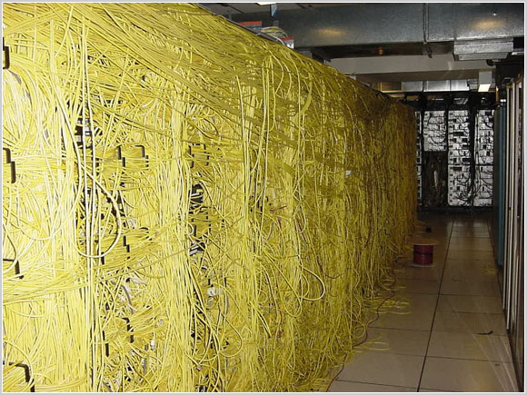

Slide 10
Office Deployment
Tapping a HA pair of switches or firewalls with SPAN ports
NPB filters and sends to N moloch boxes depending on users per site
Arista 7150S-24 (or -52)
24x10TB RAID 6 = 200TB
About 250 users per moloch for our retention
Runs moloch, bro, suricata, other tools
OOB & OS Switch
Everything is also connected to a OOB switch and a normal switch for OS
OOB
FW 1
FW2
SWI
T
C
H
NPB
Moloch 1
Moloch N

Slide 11
Prod Deployment
Tapping many links in 2 comm rooms using optical taps
Tapped links are 10g, 40g, 100g
Depending on where encryption is done, tapping may be between router and wave or south of router
NPB per communication room, NPB 2 sends traffic to NPB 1
Arista 7504R
Filters traffic
2x100g links
NPB 1 distributes traffic to moloch
10g links
Required because traffic is multi pathed
COMM 2
COMM 1
IXIA Taps
IXIA Taps
NPB 2
NPB1
Moloch 1
Moloch N

Slide 12
Multi Tier Deployment
1
….
Monitored traffic identified by dot1Q tag
Spine Aggregators pass through ID tags and timestamps
2
….
To tools
3
….
18
….
tool port (channel) (identity disabled)
Spine Aggregator
Leaf Aggregators identify sources with dot1q tags towards spine
tap ports
Use Agile Ports for high capacity interconnects
Unique identity tags applied to each each aggregator’s sources
tool port or portchannel as uplink (identity enabled)
tool port or portchannel as uplink (identity enabled)
Leaf Aggregator 1
Leaf Aggregator 2
tap ports
tap ports
Id:1
Id:2
Id:3
Id:4
Id:5
Id:6
Id:7
Id:8
Id:9
Id:10
Id:11
Id:12
Id:13
Id:14
Id:15
Id:16
Id:17
Id:18
Notes:
‹#›

Slide 13
Why Oath chose Arista
IPv6 support
100G support
Other vendors had issues around number of ports, cost of ports, type of 100G connector
MPLS stripping support
many vendors require dedicated controller card or limit total bandwidth when required
Not perfect, Arista requires physical loopback for MPLS stripping with symmetric load balancing
Automation was poorly supported by our previous device
Not a special device, just a switch in special mode
Cost

Slide 14
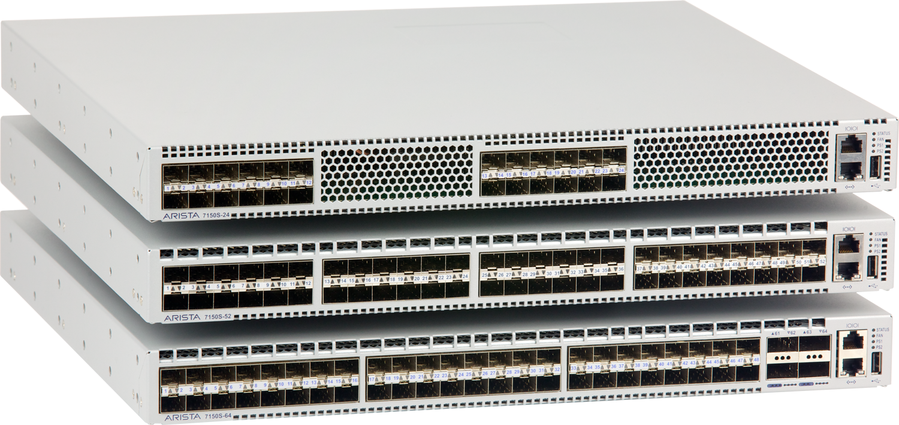
Arista 7150S Family
Resources | Arista 7150S
10G Interfaces | 24, 52 or 64 10GbE
40G Interfaces | 4, 13 or 16 40GbE
Switching Capacity | 1.28 Tbps
Forwarding Rate | 960Mpps
L2 Table Size (u/mcast) | 64K / 36K
L3 Table Size (u/mcast) | 84K / 23K
350ns Latency
Lowest Jitter
SSD Option

Slide 15
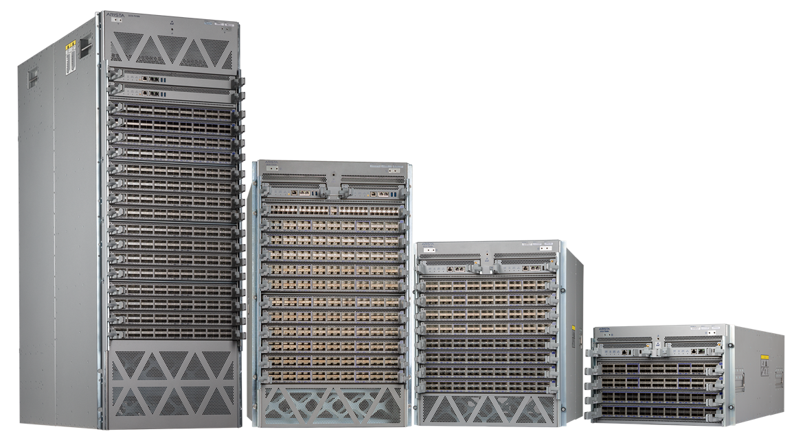
Arista 7500R and 7280R Family
Common single EOS image, Deep Buffer, Lossless Architecture, Large Tables
Choice of form factors, density and port speeds for varying use cases
Standards based switching for reliable deployments
10G, 40G and 100G Line cards
7500R Series
30 100G QSFP
48 10G-T and 6 100G
24 40G and 12 100G QSFP
48 100G and 8 40G QSFP
48 10G-SFP and 6 100G
48 25G SFP and 6 100G
56 40G and 16 100G QSFP
60 100G QSFP

